Slide 1

Demand data analysis
Joaquin Tempelsman

Slide 2
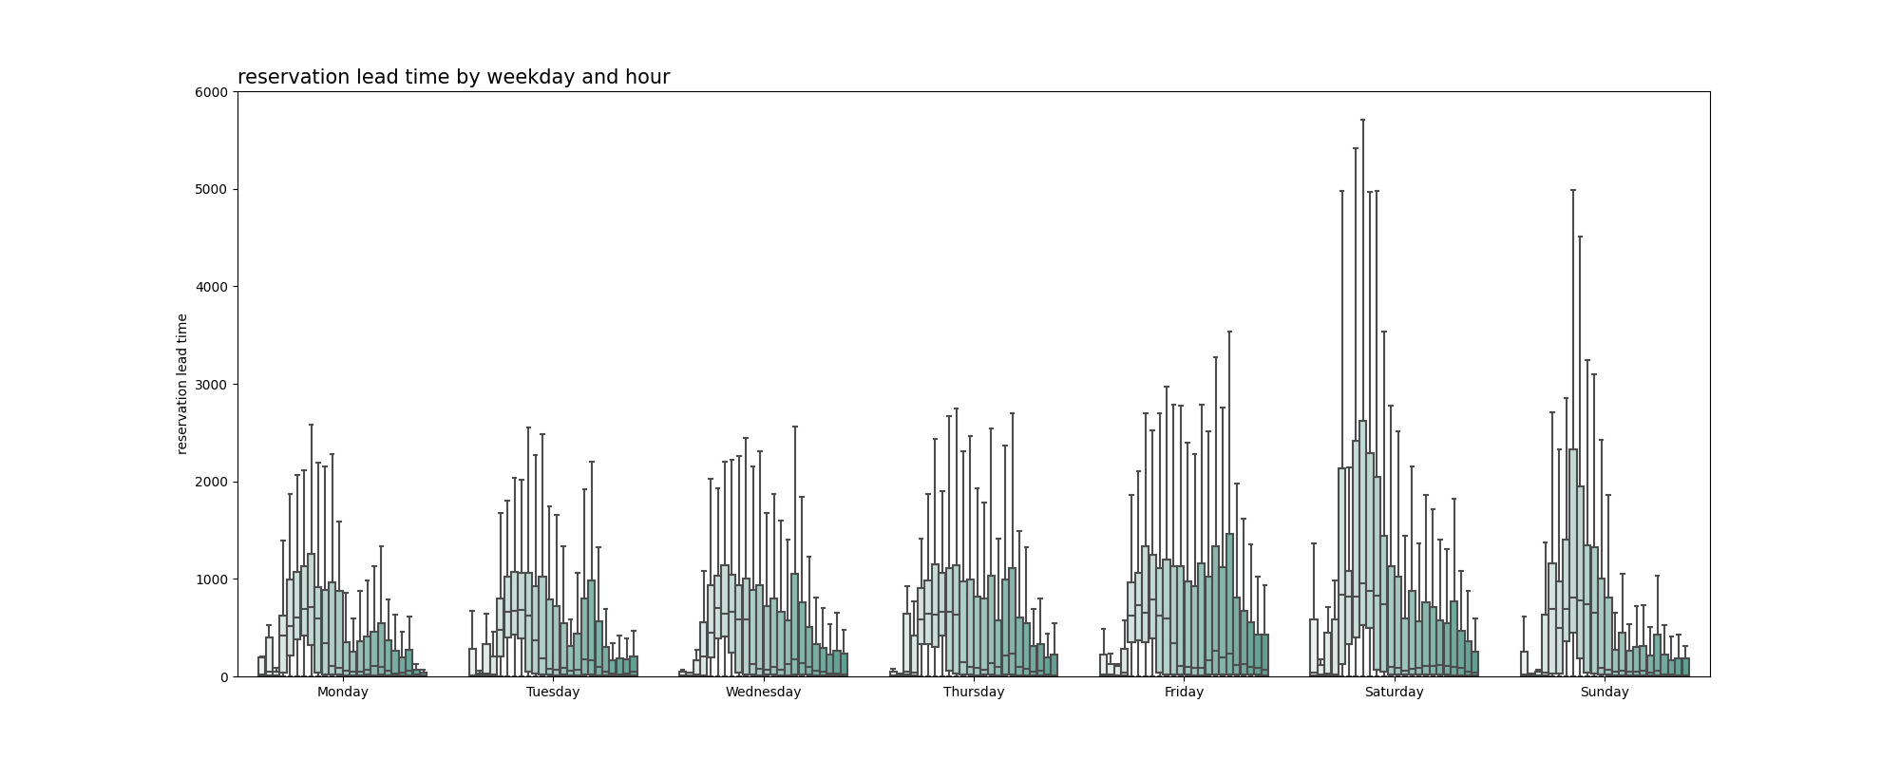
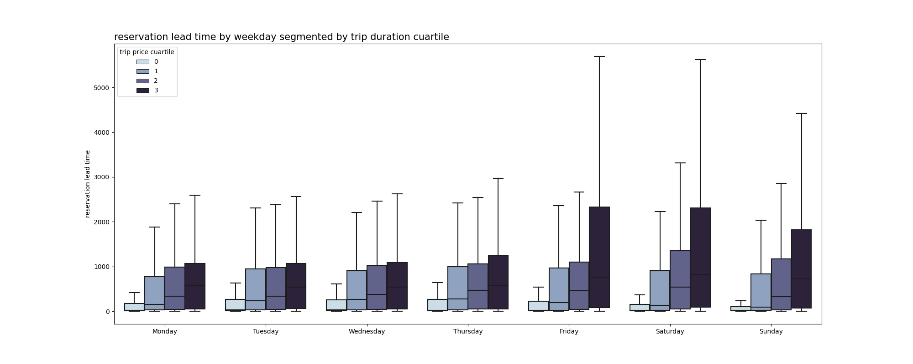
Reservation lead time by starting time of the trip
grouped by Weekday and Hour
Trips starting on saturday and sundays have more lead time than trips during the week. Probably associated with longer planned holiday trips vs unplanned utilization during daily errands and commute to work.
Reservation lead time by starting time of the trip
Group by Weekday and Trip duration quartile
The duration of the trip is positively associated with the lead time for the reservation. If the reservation is longer, there is a tendency in making the reservation in advance. This relationship is relevant for weekend reservations and don't apply to the rest of the week.

Slide 3
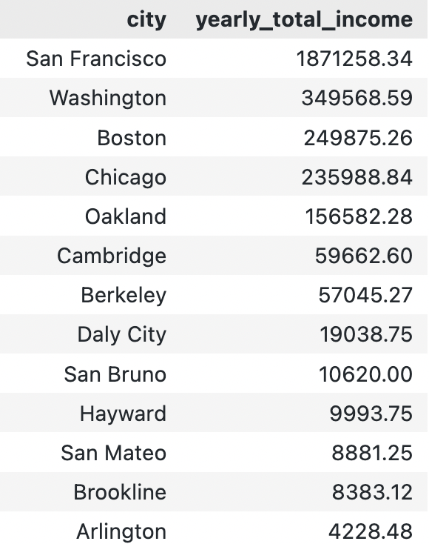
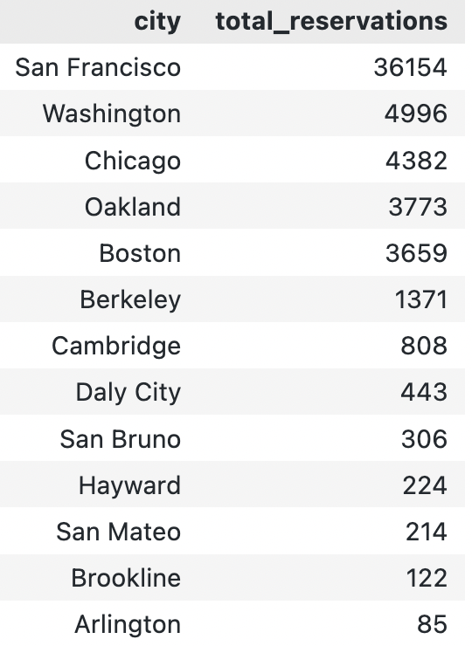
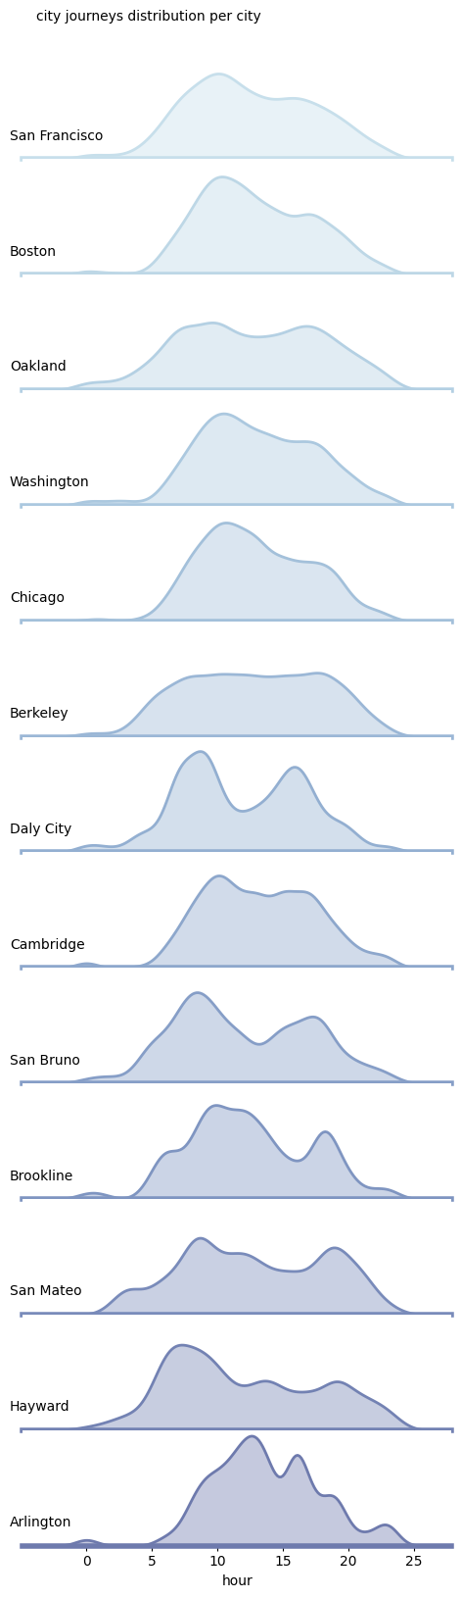
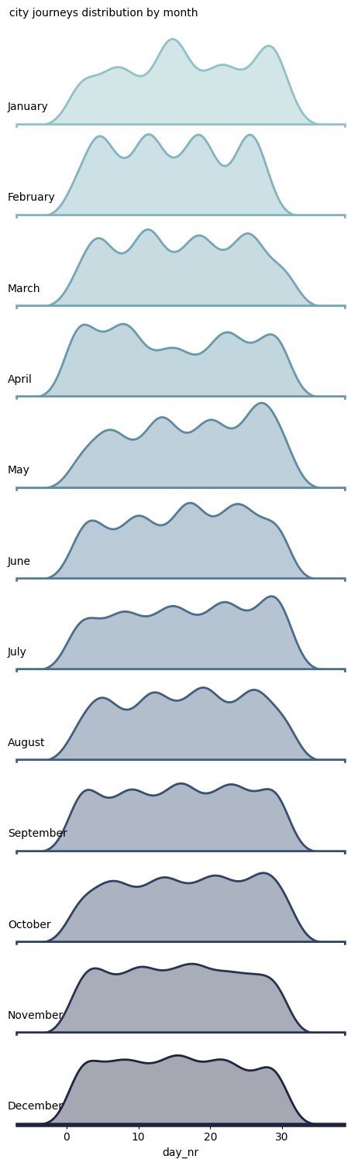
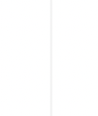
reservations distribution
City
reservations distribution
Monthly
Most cities have a similar trend in hourly utilization of the fleet. Except some specific locations that have low activity during the middle of the day and more concentration during rush hour (Daly City).
Monthly demand have higher variability during the first months of the year and is more stable and evenly distributed during the rest of the year with december being the most evenly distributed month.

Slide 4
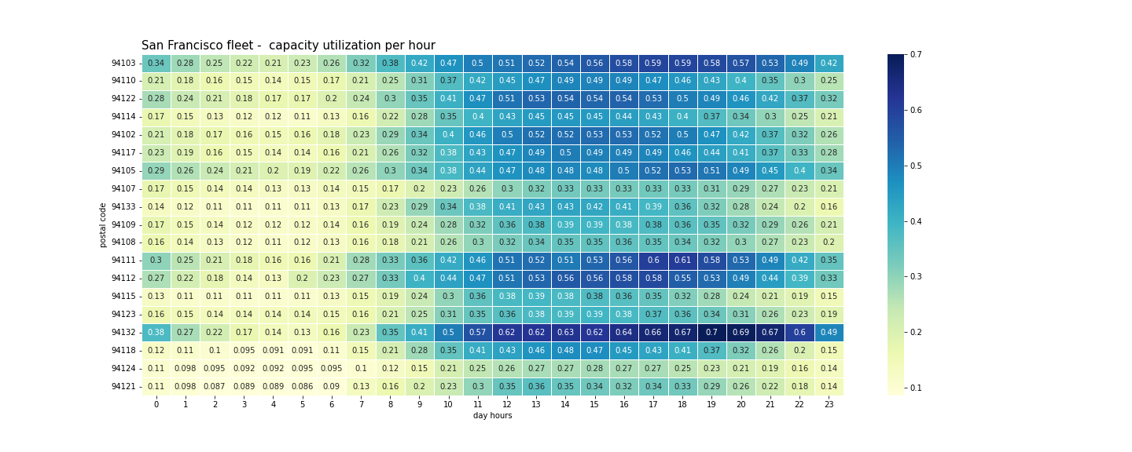
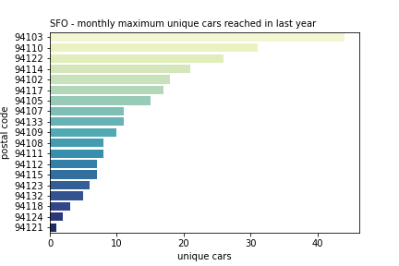
SFO fleet capacity by Hour and Zip Code
Utilization of the car fleet incurs during working hours peaking around 15hs. This trend is smoothly repeated through all the SFO area.
SFO - cars available per Zip code
The fleet is not evenly distributed through the SFO zip codes. We can detect that some areas are needing more resources that could be relocated from other areas. For example zip code 94132 has the highest utilization treds with less than 10 hours assigned.

Slide 5
THANKS!
Any questions?
Joaquín Tempelsman

